Slide 1
Vehicle service assistance
Thomas Mathew sunny

Slide 2
Project Description: 🚗
The Vehicle Service Management Portal is a web-based application designed to simplify and streamline the process of vehicle servicing for both customers and service providers. It provides a digital platform where vehicle owners can register their service requests, service center staff can manage these requests and assign drivers, and drivers can collect vehicles and update service statuses. The system ensures smooth coordination between all three roles with real-time updates and location sharing, improving operational efficiency and customer experience.

Slide 3
modules
Admin
Driver
Customer

Slide 4
ADMIN
Login
Add, update, and remove services from the catalog.
Add, update, and remove drivers from the catalog(CRUD)
View all incoming service requests
Assign available driver to a service request
Manage transactions
View service history
Update service status(In progress, Completed, Delivered)
View feedback

Slide 5
DRIVER
Register/Login
View assigned pickup requests
Access customer location and contact info
Update vehicle status

Slide 6
CUSTOMER
Register/Login
View Services
Register vehicle for service (vehicle details, address, contact, preferred time)
View driver info
Manage Payment
Track service status (Requested → Picked up → In Service → Ready → Delivered)
View service history
Add feedback

Slide 7
UML diagrams

Slide 8
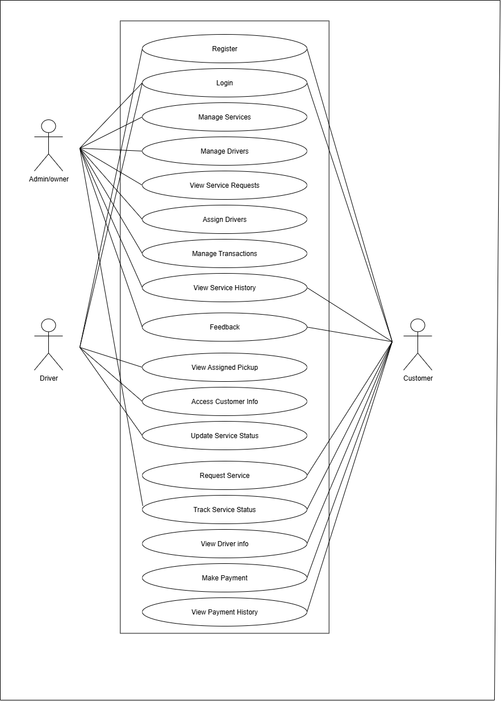
USE CASE DIAGRAM

Slide 9
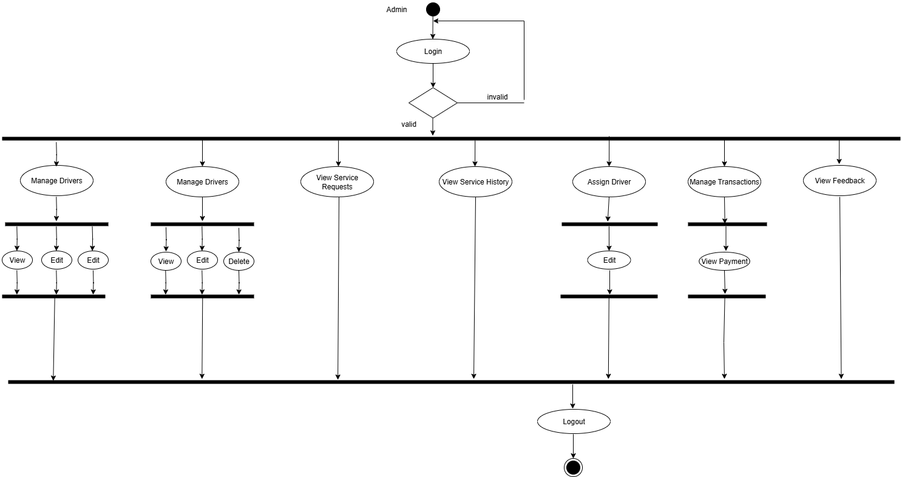
ADMIN ACTIVITY DIAGRAM

Slide 10
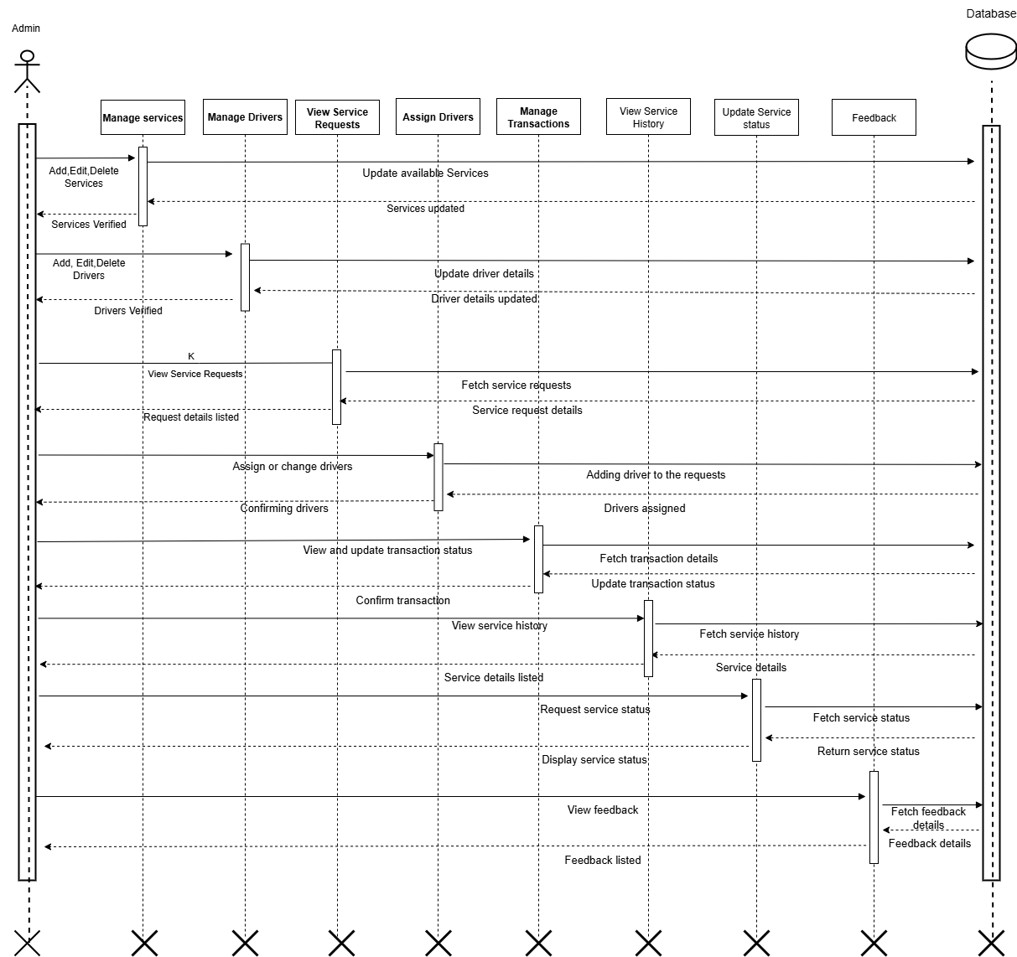
ADMIN SEQUENCE DIAGRAM

Slide 11
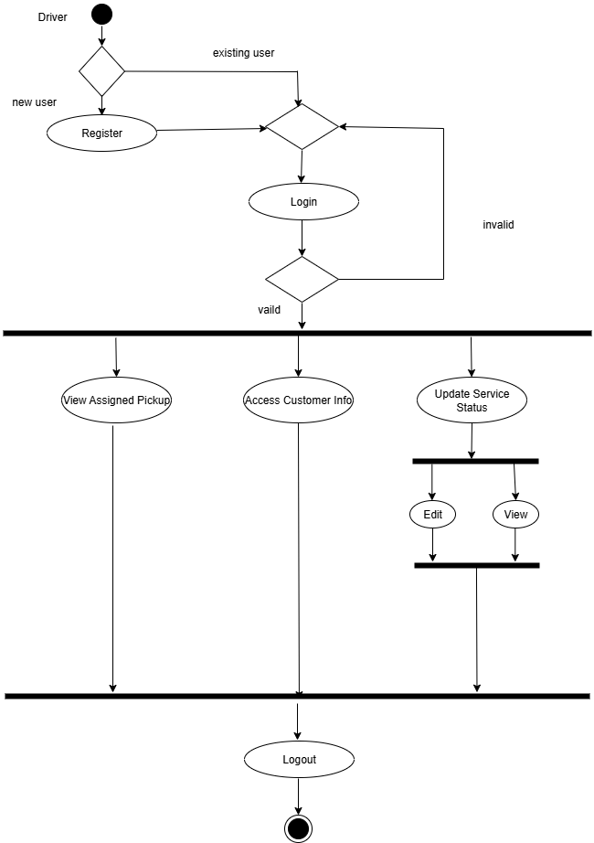
DRIVER ACTIVITY DIAGRAM

Slide 12
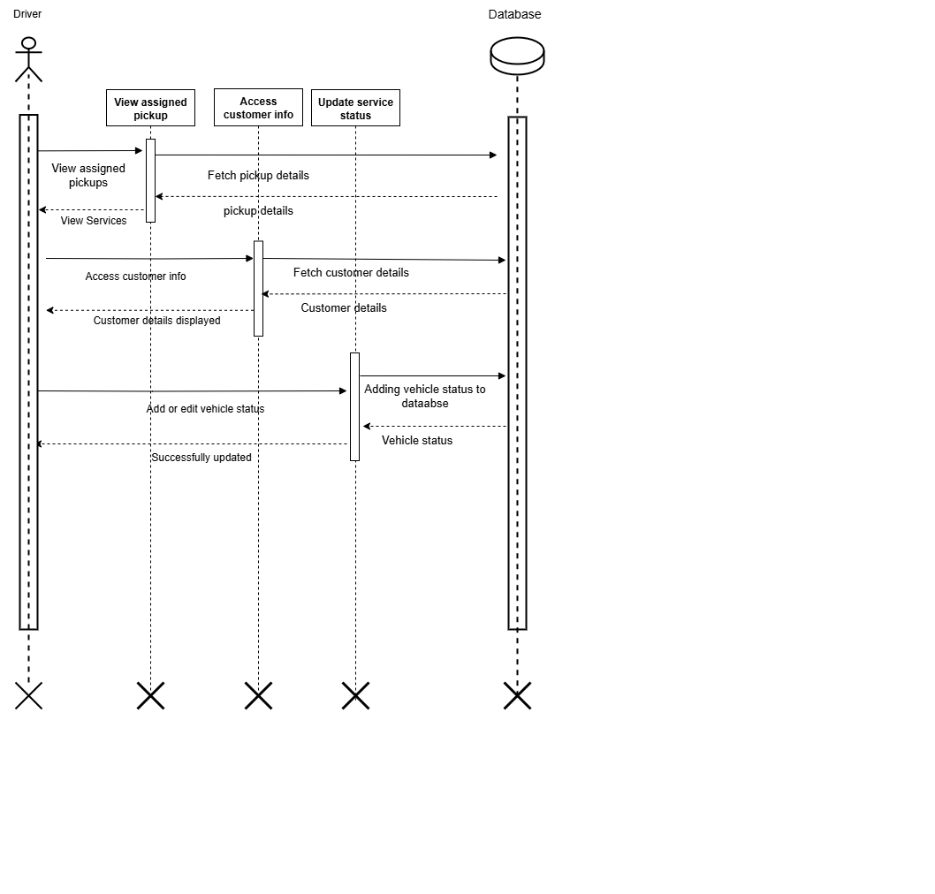
DRIVER SEQUENCE DIAGRAM

Slide 13
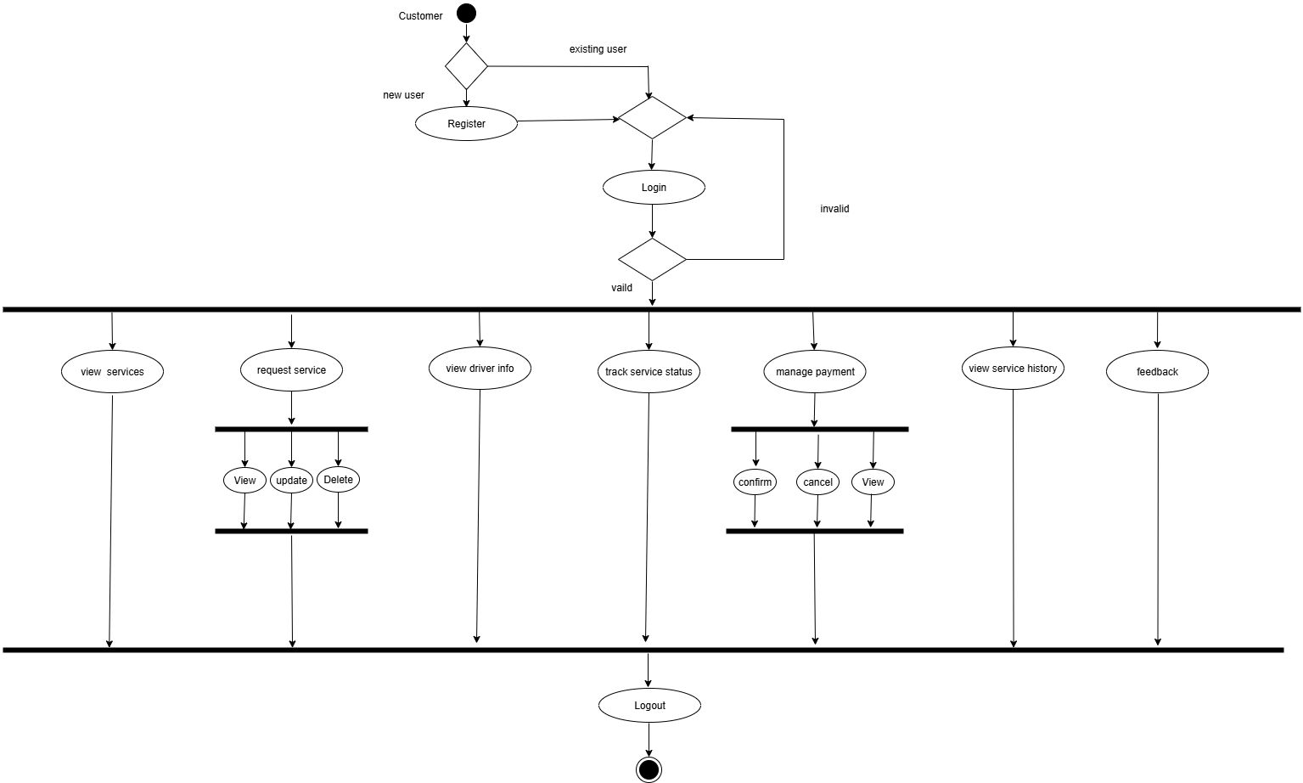
CUSTOMER ACTIVITY DIAGRAM

Slide 14
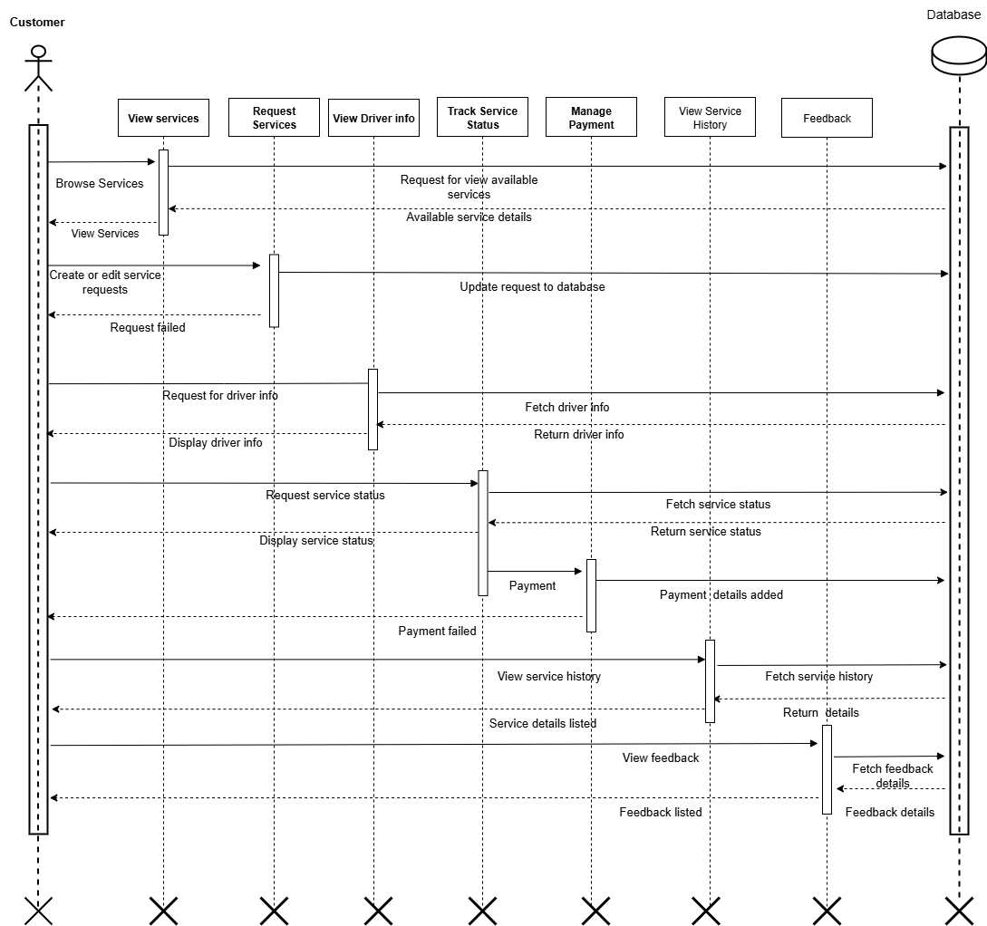
CUSTOMER SEQUENCE DIAGRAM

Slide 15
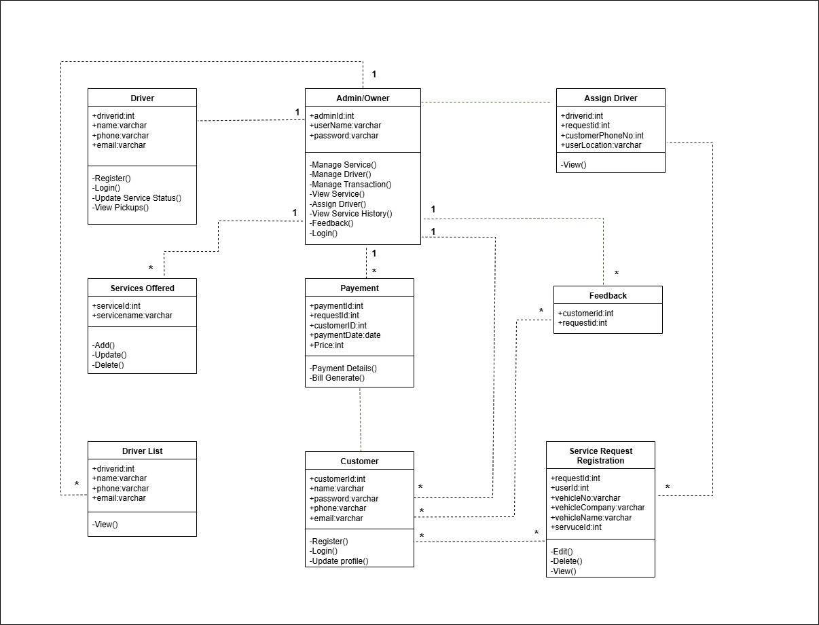
CLASS DIAGRAM

